Slide 1


Data Privacy(数据的隐私性)
SE3331-1 (2022 Fall)
IPADS, Shanghai Jiao Tong University
https://www.sjtu.edu.cn
Notes:
Credits to Mike Freedman (COS 461) and others.

Slide 2
Data Privacy
Data can be used everywhere
Risk management
Medicine
Recommended system
…
Data can be stolen easily
Everyone who uses your data can steal it

Slide 3
Data Privacy
What’s the target of data privacy system?
Allow data to be used, and protect it from being stolen
Today's contents
Basic data privacy method
ZKP, OT, HE, sMPC, TEE, DP
Systems which try to enforce data privacy
数据隐私性的目标：
允许数据被正常使用，但与此同时不允许数据被他人窃取。

Slide 4
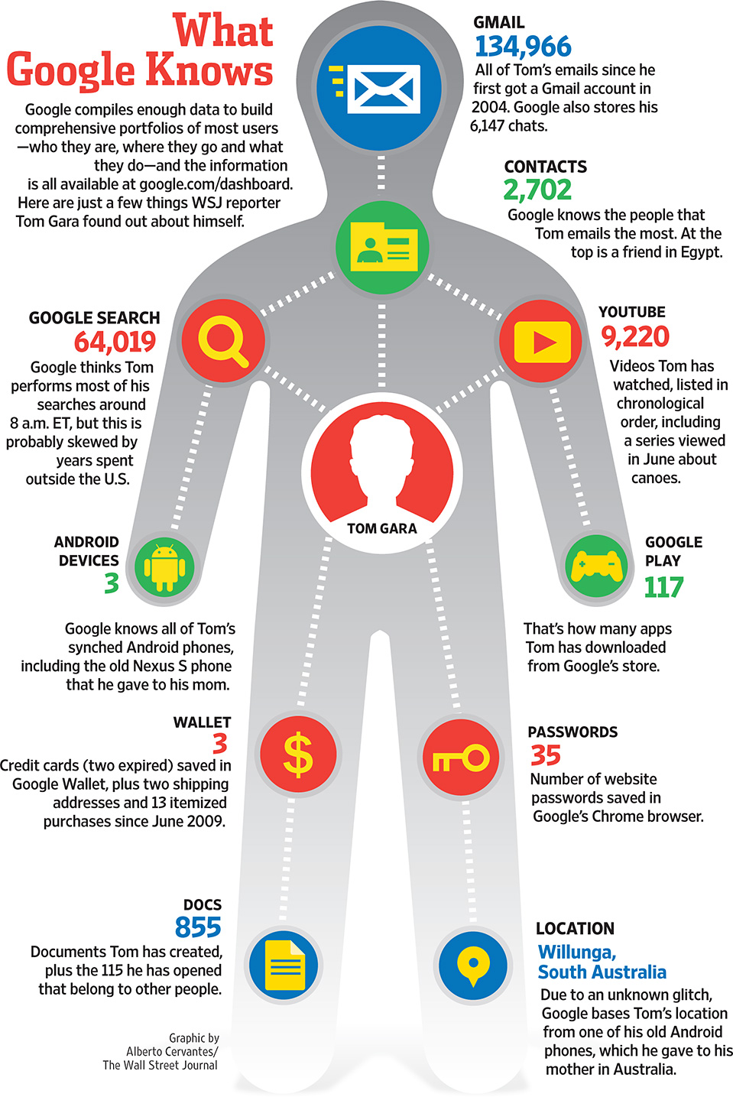


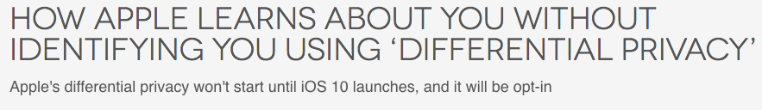

The Price of Free: Privacy

Slide 5
Common Attacks
An adversary may learn about data:
From ciphertext(加密文本) (ciphertext representation-based attack, e.g., order of values)
From prior knowledge of data distribution (frequency-count attack)
From knowledge of frequency of queries (workload-skew attack)
From the size of the output to a query (output-size attack)
From the access pattern used by the mechanism in answering a query (access-pattern attack)
From knowledge of queries that have executed (search-pattern attack)
Mix with adversarial background knowledge
Data Privacy compromised!!

Slide 6
Data Privacy
Will data be vulnerable to misuse?
What's the target of data privacy system?
Allow data to be used, and
Protect data from being stolen
What will be introduced?
Basic data privacy method
HE, ZKP, sMPC, SS, OT, GC, DP, TEE, …
Systems which try to enforce data privacy

Slide 7
Zero-Knowledge Proof

Slide 8


Problem
ZKP中的proof在生活中的常见例子：短信验证码等
I have the answer A of the problem P!
It's impossible!
Prove it!
A
Alice
Bob
Alice tries to prove to Bob that she has the answer of a difficult problem (e.g., a NP problem)
Naïve method: Sending A to Bob

Slide 9
Problem
I have the answer A of the problem P!
Thanks!
Now, I have the answer A.
A
Alice
Bob
Alice tries to prove to Bob that she has the answer of a difficult problem (e.g., a NP problem)
Naïve method: Sending A to Bob
Problem: Bob will get the answer A(这与数据的隐私性矛盾了)

Slide 10

Zero-Knowledge Proof (ZKP)
I have the answer A of the problem P!
Thanks!
Now, I have the answer A.
proof
Alice
Bob
Alice tries to prove to Bob that she has the answer of a difficult problem (e.g., a NP problem)
Zero-Knowledge Proof
Completeness(完备性): Alice can construct the proof if she has A
Soundness:(可靠性) Alice cannot construct the proof if she doesn't have A
Zero-knowledge: Bob knows nothing about A

Slide 11
Zero-Knowledge Proof (ZKP)
Scenario: Alice has Bob's public key. Alice wants Bob to prove his identity.
Alice
Bob
Bob's public key
Bob's private key
A random value r
E(r)
E(r) ← Enc(r, Key_{prv})
If Dec(E(r), Key_{pub}) → r, then Bob's identity can be proved

Slide 12
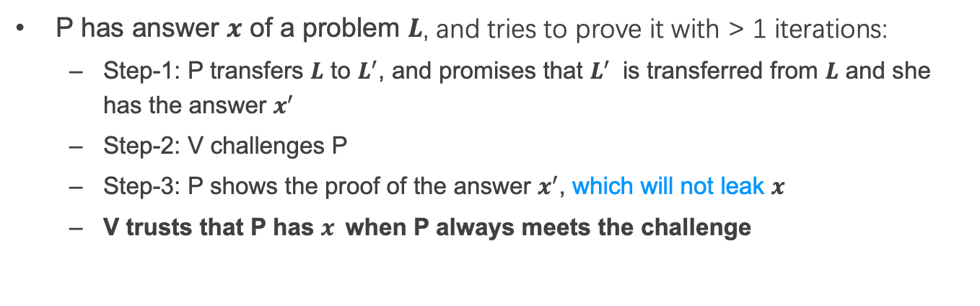
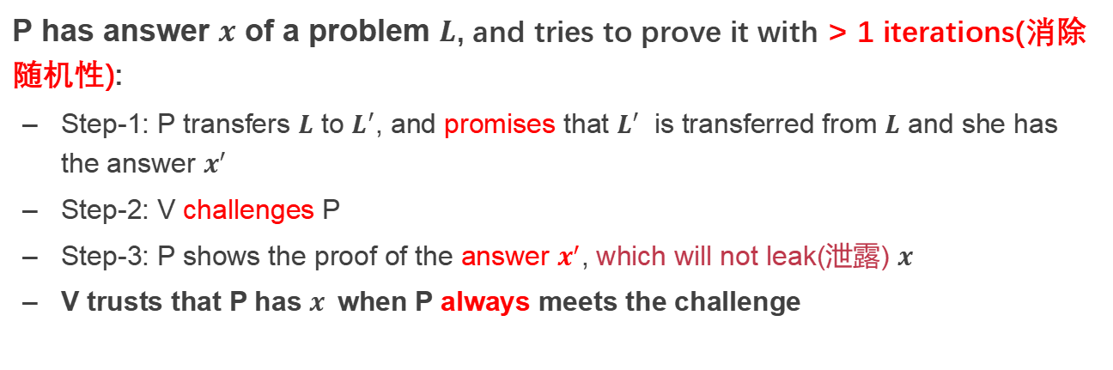
Interactive Zero-Knowledge Proof
I am verifier.
I am prover.
promise
1
challenge
Alice
response
Bob
2
P has answer $x$ of a problem $L$, and tries to prove it with > 1 iterations(消除随机性):
Step-1: P transfers $L$ to $L^{′}$, and promises that $L^{′}$ is transferred from $L$ and she has the answer $x^{′}$
Step-2: V challenges P
Step-3: P shows the proof of the answer $x^{′}$, which will not leak(泄露) $x$
V trusts that P has $x$when P always meets the challenge

Slide 13
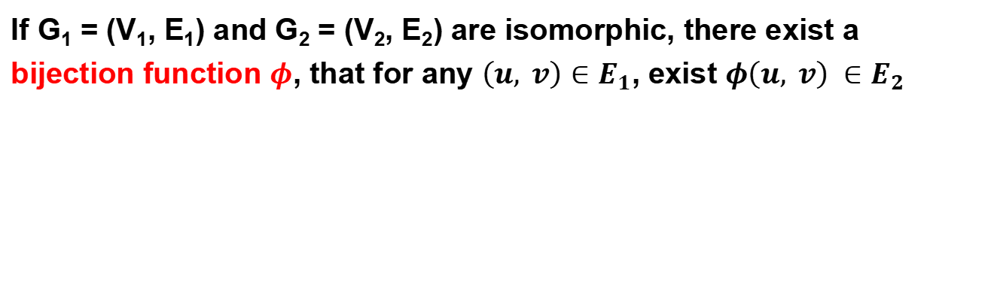
Scenario: Graph Isomorphism(图的同构性)
2
1
1
4
2
4
3
3
6
5
5
6
G_{e}
G_{f}
If G₁ = (V₁, E₁) and G₂ = (V₂, E₂) are isomorphic, there exist a bijection function $φ$, that for any $\left(u, v\right)∈E_{1}$, exist $φ\left(u, v\right) ∈E_{2}$

Slide 14
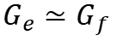
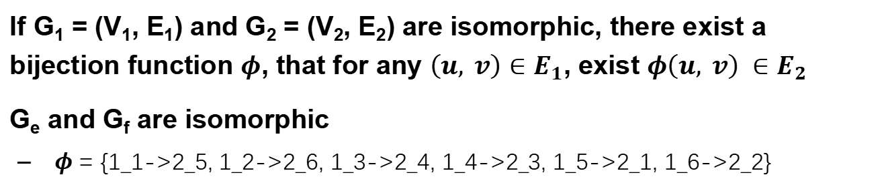
Scenario: Graph Isomorphism
2
1
1
$$G_{e}≃G_{f}$$
4
2
4
3
3
6
5
5
6
G_{e}
G_{f}
If G₁ = (V₁, E₁) and G₂ = (V₂, E₂) are isomorphic, there exist a bijection function $φ$, that for any $\left(u, v\right)∈E_{1}$, exist $φ\left(u, v\right) ∈E_{2}$
G_{e} and G_{f} are isomorphic
$φ$ = {1_1->2_5, 1_2->2_6, 1_3->2_4, 1_4->2_3, 1_5->2_1, 1_6->2_2}

Slide 15

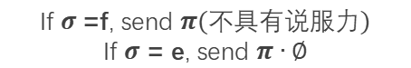

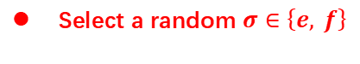

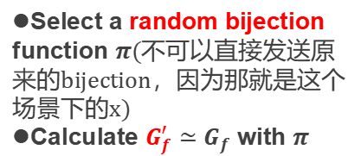
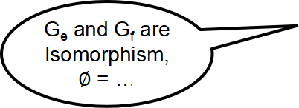
Graph Isomorphism with Interactive ZKP
对于随机选择的e/f，若选择到f，那么结果不具有说服力，因为f‘和f同构的双射函数是随机获取的，并不能说明A确实找到了一个双射使得图f和图e是同构的，只有当选取的是e，才能真正验证，因为需要先对图e运行双射φ变成图f，之后运行双射π去得到图f’.
如果A确实可以给出这样的双射函数，B可以做到这一点，说明A确实有。
G_{e} and G_{f} are Isomorphism, $∅$ = …
Alice
Bob
Select a random bijection function $π$(不可以直接发送原来的bijection，因为那就是这个场景下的x)
Calculate $G_{f}^{′}≃G_{f}$ with $π$
$G_{f}^{′}$ $≃G_{f}$ $≃G_{e}$
Ask Alice to prove ${G_{σ}≃G}_{f}^{′}$
Select a random $σ∈\left\{e, f\right\}$
If $σ$=f, send $π(不具有说服力)$
If $σ$ = e, send $π∙∅$
Verify that ${G_{σ}≃G}_{f}^{′}$
Require multiple interactions(一次失败那么全局失败)
Notes:
$∅$ Phi
σSigma

Slide 16
PIR
Private Information Retrieval

Slide 17

Private Information Retrieval (PIR)
I want to know something about cancer.
query
Alice
Server
Alice wants to retrieve a file stored on a server without any information on which file is being retrieved
Naïve method: Download everything from server(显然不现实)

Slide 18
Private Information Retrieval (PIR)
Goal: allow user to query database while hiding the identity of the data-items she is after.
Note: hides identity of data-items; not existence of interaction with the user.
Motivation: patient databases; stock quotes; web access; many more....
Paradox(?): imagine buying in a store without the seller knowing what you buy.

Slide 19
Private Information Retrieval (PIR)
Information-Theoretic PIR
Replicate database among k servers
User queries all the servers
Computational PIR
Computational privacy, based on cryptographic assumptions

Slide 20
2-Server PIR
n
0
1
0
0
1
1
0
1
0
0
1
0
S₁
i
S₂
i
U

Slide 21
2-Server PIR
n
0
1
0
0
1
1
0
1
0
0
1
0
S₁
i
S₂
Q₁ subset {1,…,n}
i
U

Slide 22
2-Server PIR
n
0
0
1
0
0
1
1
0
1
0
0
1
0
S₁
i
S₂
Q₁ subset {1,…,n}
i
U

Slide 23
2-Server PIR
n
0
0
1
0
0
1
1
0
1
0
0
1
0
S₁
i
S₂
Q₂=Q₁ + {i}
Q₁ subset {1,…,n}
i
U

Slide 24
2-Server PIR
n
0
0
1
0
0
1
1
0
1
0
0
1
0
1
S₁
i
S₂
(实际上发送给S1的请求是没用的)
Q₂=Q₁ + {i}
Q₁ subset {1,…,n}
S1和S2不能串通指的是由于S1和S2是知道用户的具体请求信息的，若两个S之间进行非法通信，那么通过比较就会得到用户真正要访问的i，就会导致数据泄露
i
会返回给用户很多用户本来不需要的数据
U
Weakness: Servers should not collude(串通)!

Slide 25
2-Server PIR
n
0
0
1
0
0
1
1
0
1
0
0
1
0
1
S₁
i
S₂
Q₂=Q₁ + {i}
Q₁ subset {1,…,n}
i
U
Notice: Servers should not collude!

Slide 26
OT
Oblivious Transfer

Slide 27
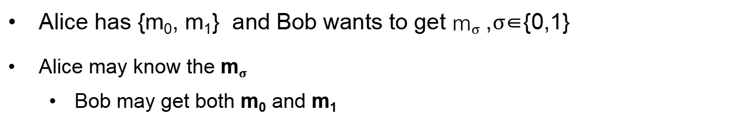
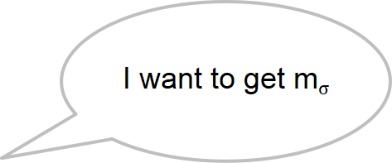
Problem
I have {m₀, m₁}
I want to get m$σ$
Alice
Bob
Alice has {m₀, m₁} and Bob wants to get m$σ$ ,$σ$∈{0,1}
Alice may know the m$σ$
Bob may get both m₀ and m₁

Slide 28
Oblivious Transfer (OT)
Introduced by Michael O. Rabin, 1981
Scenario: message transfer
A sender has a message list {m₀, m₁, … , m_{n}}
A receiver wants to get k target messages from sender
Properties: oblivious and secure
Oblivious(未察觉的): sender cannot know which messages are received
Secure: receiver can only get the target messages

Slide 29
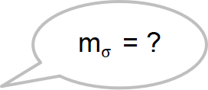
1-out-of-2 OT (Solution-1)
Scenario: RSA encryption
{m₀, m₁}
m$σ$ = ?
Alice
Bob
Generate 2 key pairs {K0_{pub}, K0_{prv}}, {K1_{pub}, K1_{prv}}
K0_{pub}, K1_{pub}
(oblivious:sender不知道用户需要那个数据)
Generate a random number r
c ← Enc(Kσ_{pub}, r)
c
k₀ ← Dec(K0_{prv}, c)
k₁ ← Dec(K1_{prv}, c)
e₀ ← k₀ ⊕ m₀
e₁ ← k₁ ⊕ m₁
(secure:用户只会获取自己索取的数据)
e₀, e₁
m_{σ} ← e_{σ} ⊕ r
比如想获取m0，那么k0就是r。

Slide 30


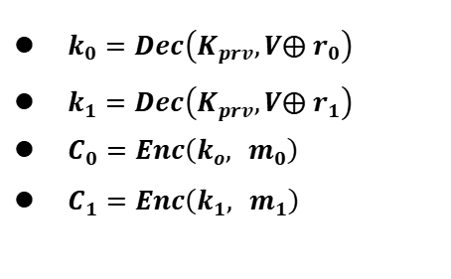

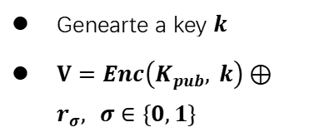

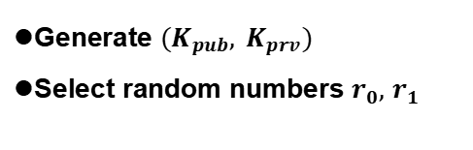
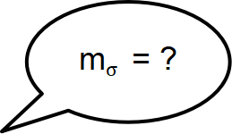
1-out-of-2 OT (Solution-2)
m$σ$ = ?
{m₀, m₁}
Alice
Bob
Generate ${(K}_{pub}, K_{prv})$
Select random numbers $r_{0},$ $r_{1}$
$$K_{pub}, r_{0},r_{1}$$
Genearte a key $k$
$V=Enc\left(K_{pub}, k\right)⊕r_{σ}, σ∈\{0,1\}$
$$V$$
$k_{0}=Dec\left(K_{prv},V⨁{ r}_{0}\right)$
$k_{1}=Dec\left(K_{prv},V⨁{ r}_{1}\right)$
$C_{0}=Enc\left(k_{o}, { m}_{0}\right)$
$C_{1}=Enc\left(k_{1}, { m}_{1}\right)$
$$C_{o},C_{1}$$
$m_{σ} =Dec\left(k, C_{σ}\right)$
Notes:
Alice分别用两个解密结果加密她的两份消息，将加密结果送给Bob （Ci=E(ki, mi) i=0,1）
Bob用k解密两份密文，得到需要的秘密 s

Slide 31
More OT Protocols
Different numbers of selected messages
1-out-of-2 OT
1-out-of-n OT
k-out-of-n OT
Implementation method
Non-adaptive OT
Adaptive OT
Publicly Verifiable OT
…

Slide 32
DP(差分隐私)
Differential privacy

Slide 33


Problem
Name | Salary
Alice | 100
Bob | 80
Brown | 200
Tom | 120
SUM(Salary)
500
Alice can perform queries on Bob’s database, but cannot access a single database entry

Slide 34
Problem
Name | Salary
Alice | 100
Bob | 80
Brown | 200
Tom | 120
SUM(Salary) where Name == “Tom”
Reject
Alice can perform queries on Bob’s database, but cannot access a single database entry
Naïve method: reject Alice to access single entry

Slide 35
Problem
Tom has 120
Name | Salary
Alice | 100
Bob | 80
Brown | 200
Tom | 120
SUM(Salary)
500
SUM(Salary) where Name != “Tom”
380
Alice can perform queries on Bob’s database, but cannot access a single database entry
Naïve method: reject Alice to access single entry

Slide 36
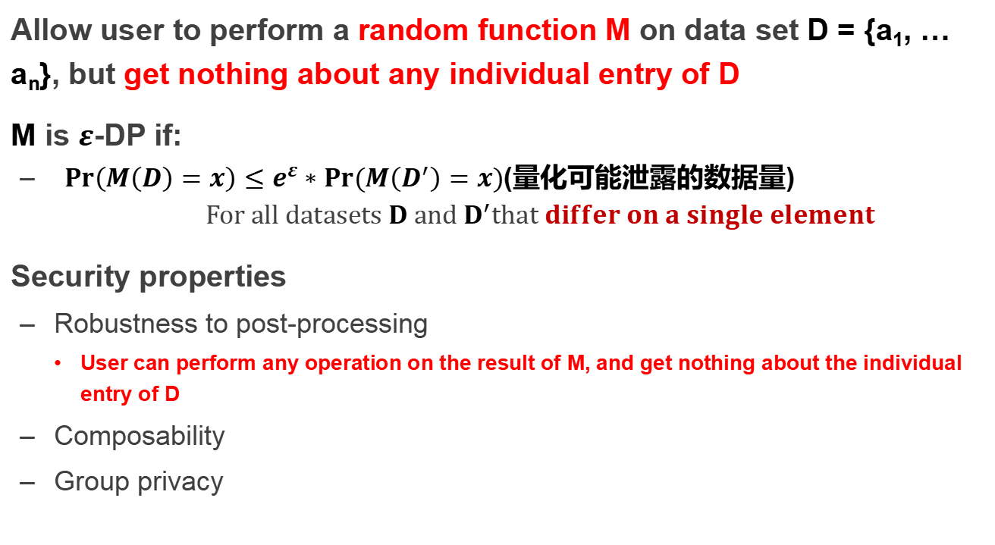
Differential privacy
Allow user to perform a random function M on data set D = {a₁, … a_{n}}, but get nothing about any individual entry of D
M is $ε$-DP if:
${Pr\left(M\left(D\right)=x\right)}≤e^{ε}∗Pr⁡(M\left(D^{′}\right)=x)$(量化可能泄露的数据量) $$For all datasets D and D^{′}that differ on a single element$$
Security properties
Robustness to post-processing
User can perform any operation on the result of M, and get nothing about the individual entry of D
Composability
Group privacy
ε越大，那么DP算法结果越随机，那么用户就更难通过差值知道具体的某一条数据，反之则越容易。

Slide 37
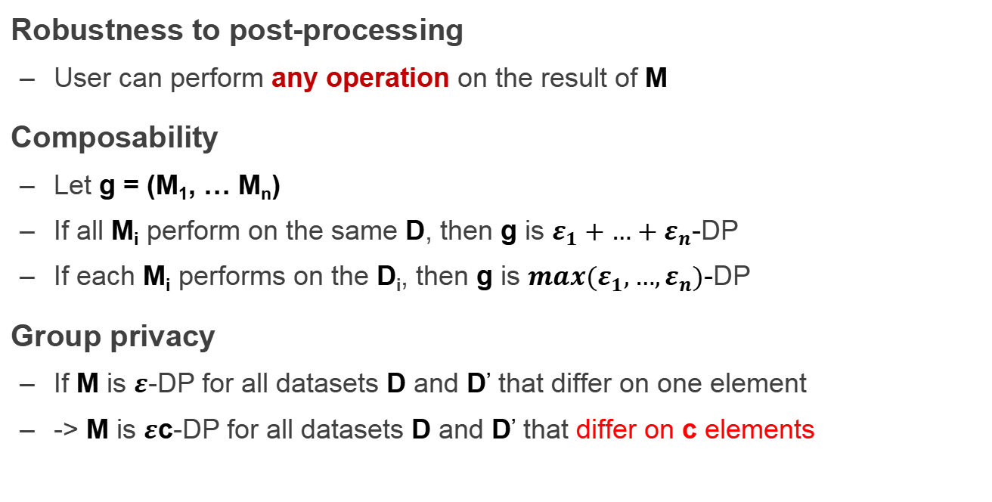
Properties of Differential privacy
Robustness to post-processing
User can perform any operation on the result of M
Composability
Let g = (M₁, … M_{n})
If all M_{i} perform on the same D, then g is $ε_{1}+…+ε_{n}$-DP
If each M_{i} performs on the D_{i}, then g is ${max(ε}_{1},…,ε_{n})$-DP
Group privacy
If M is $ε$-DP for all datasets D and D’ that differ on one element
-> M is $ε$c-DP for all datasets D and D’ that differ on c elements

Slide 38
How to Implement a DP Algorithm
Adding noisy to the function that we want to compute
Translate the function f to a random algorithm M(消除结果的确定性，从而使得很难通过数据差值的方式来获取一些private data)
Existing Mechanism
Laplace mechanism
Gaussian mechanism
…

Slide 39
When DP is Enabled
…
Name | Salary
Alice | 100
Bob | 80
Brown | 200
Tom | 120
SUM(Salary)
~480
SUM(Salary) where Name != “Tom”
~480

Slide 40
Secret Sharing

Slide 41
Secret Sharing
Introduced by Adi Shamir, 1979
Key Insight: One point constructs infinite number of lines, two points construct only one line
Key Idea: Split a secret data into n shares, at least k shares can reconstruct the secret ((k,n)-SS)

Slide 42

Secret Sharing
Each part cannot learn the secret S
Secret-Share Creation:
(under the assumption that no part will collude)
这个前提很重要，不然的话，单个share可以通过与其他share通信来获取数据
share 1
part 1
将最终data想象成一个三维空间，将每个share part想成一个空间点，那么由于三个不共线的点才能够确定一个平面，所以单独每一个share都不能完全获取这个数据，同时，由于三个点就能存储一个数据面，那么在左图中的5个share的情况下，即使有两个share出现问题，也仍然能正常获取完全的数据S。
share 2
secret data S
part 2
share 3
secret owner
share n
part 3
Mathematical operations
f(x) = S + a₁x + a₂x + ... + a_{k-1}x^{k-1}
…
part n

Slide 43
Secret Sharing
Each part cannot learn the secret S
Secret Reconstruction:
(under the assumption that no part will collude)
share 1
part 1
share 2
secret data S
part 2
share k
secret owner
part 3
Lagrange Interpolation
…
part n

Slide 44
Secret Sharing
Each part cannot learn the secret S
Secret Reconstruction:
(under the assumption that no part will collude)
share 1
part 1
secret data S
part 2
share 3
share k
secret owner
part 3
Lagrange Interpolation
…
part n

Slide 45
Pros and Cons
An information-theoretically secure protocol (unconditionally secure, independent of adversary's computational capabilities → quantum-safe)
Ideal assumption (At least k parts never collude)
Communication overhead

Slide 46
Secure MPC
Multi-Party Computing

Slide 47
secure Multi-Party Computation (sMPC)
We want to calculate
f(data₁, data₂)
I have data₁
I have data₂
Alice
Bob
Multiple parties (at least 2) work together to calculate a function
Enforce the data privacy for each party

Slide 48
Millionaire Problem
Money: Bob has i, Alice has j, i and j are between 1 to 10
Alice
Bob
Chose a random big integer x
K = enc{Key_{pub} of Bob, x}
Decrypt with Key_{prv} of Bob ten number: c+1, c+2...c+10, get y1, y2... y10
Chose a prime number p
Calculate d1 = y1 mod p, d2 = y2 mod p, ...
For n=i to 10, d_{n}++, other no change
c=K-j
d₁ to d₁₀
Check dj, if dj == x mod p, then i > j; else i <= j

Slide 49
secure Multi-Party Computation (sMPC)
Semi-honest(半诚实) adversary
Each party must follow the protocol(但是sender和receiver可能是攻击者)
Generic protocol
Can securely compute any functionality
Multi-party computation
Secret sharing
2-party computation
GC(Garbled Circuits) + OT(Oblivious Transfer)

Slide 50
Garbled Circuits
Represent functions as Boolean circuits
Basic gates: AND, OR, NOT
Adding numbers
Comparing numbers
Multiplying numbers
Computing AES
Represent input and output as wires

Slide 51
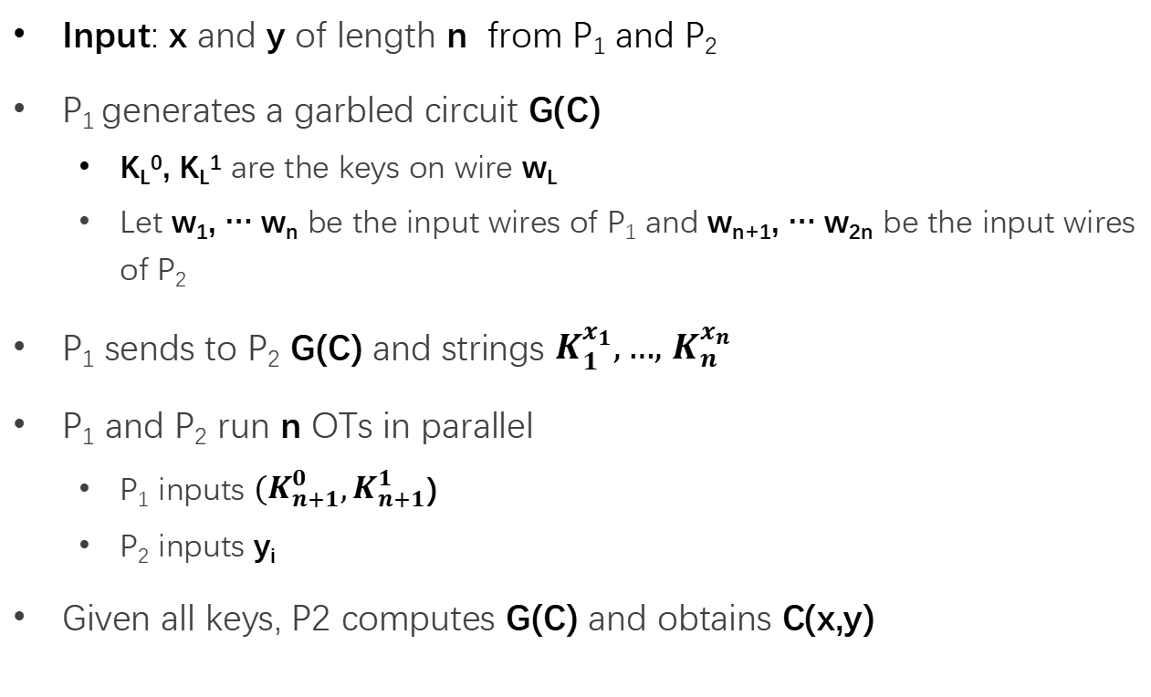
Yao's Protocol
Input: x and y of length n from P₁ and P₂
P₁ generates a garbled circuit G(C)
K_{L}⁰, K_{L}¹ are the keys on wire w_{L}
Let w₁, … w_{n} be the input wires of P₁ and w_{n+1}, … w_{2n} be the input wires of P₂
P₁ sends to P₂ G(C) and strings $K_{1}^{x_{1}},…,$ $K_{n}^{x_{n}}$
P₁ and P₂ run n OTs in parallel
P₁ inputs ${(K}_{n+1}^{0},K_{n+1}^{1}$)
P₂ inputs y_{i}
Given all keys, P2 computes G(C) and obtains C(x,y)

Slide 52
Different sMPC Protocols
Two-party
Yao's protocol
TinyOT protocol
Obliv-C
Multi-party
BMR protocol
GMW protocol
SPDZ protocol

Slide 53
Homomorphic Encryption
(同态加密)

Slide 54

Problem
I have Data!
I have computing resource!
Data
Alice
Bob (cloud)
Alice wants to ask Bob (e.g., a cloud) to perform calculation on her data
Naïve method: Sending Data to Bob

Slide 55
Problem
I have Data!
I have computing resource!
Data
Alice
Bob (cloud)
Alice wants to ask Bob (e.g., a cloud) to perform calculation on her data
Naïve method: Sending Data to Bob
Bob will get the data

Slide 56
Homomorphic Encryption (HE)
I have Data!
I have computing resource!
Alice
Bob (cloud)
CT=encrypt(Key, Data)
Function f()
CT'= Evaluate(f, CT) = Encrypt(Key, f(Data))
Get f(Data) = Decrypt(Key, CT')

Slide 57
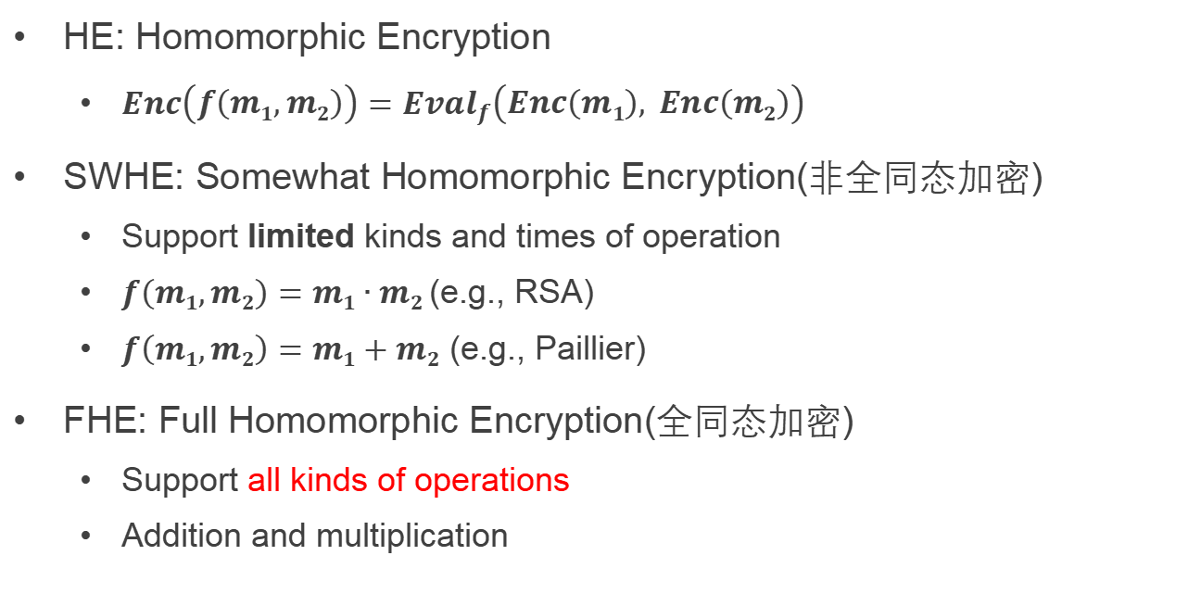
SWHE and FHE
同态加密：
对于一些运算规则，如果在加密之后仍然满足，则说对于这个运算的加密是同态加密。
这样的话就可以直接传输密文进行这个运算而不需要传递明文。
HE: Homomorphic Encryption
$Enc\left(f\left(m1,m2\right)\right)={Eval}_{f}\left(Enc\left(m1\right), Enc\left(m2\right)\right)$
SWHE: Somewhat Homomorphic Encryption(非全同态加密)
Support limited kinds and times of operation
$f\left(m1,m2\right)=m1∙m2$ (e.g., RSA)
$f\left(m1,m2\right)=m1+m2$ (e.g., Paillier)
FHE: Full Homomorphic Encryption(全同态加密)
Support all kinds of operations
Addition and multiplication

Slide 58
Hardware Enclave
Aka., TEE (Trusted Execution Environment)

Slide 59
Problem
I have Data!
I have computing resource!
Data
Alice
Bob (cloud)
Alice wants to ask Bob (e.g., a cloud) to perform calculation on her data
Naïve method: Sending Data to Bob

Slide 60
Trusted Execution Environment (TEE)
I have Data!
I have computing resource and enclave!
Data
Alice
Bob (cloud)
Alice wants to ask Bob (e.g., a cloud) to perform calculation on her data
Naïve method: Sending Data to Bob
Bob cloud construct an enclave

Slide 61
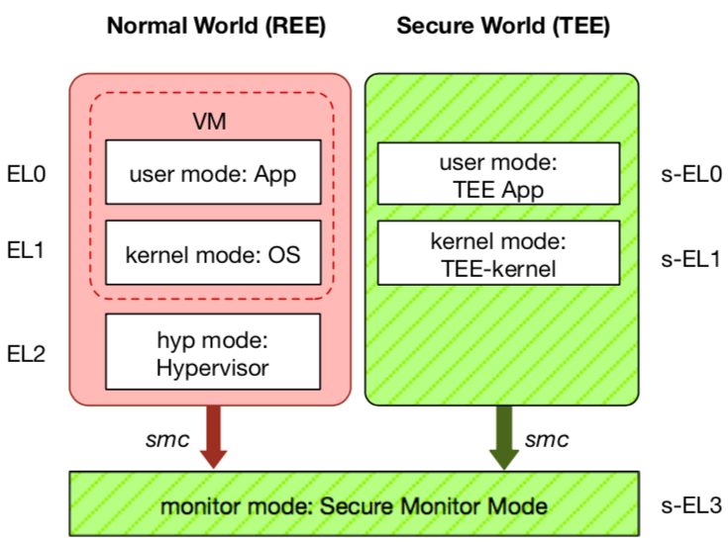
TEE: Trusted Execution Environment
Widely deployed on mobile devices
Every Android device must deploy TEE
Mostly based on ARM TrustZone
An isolated & privileged environment
TEE can access all DRAM & peripherals
REE cannot access TEE's resources
Designed to be secured and small
For security-critical tasks (e.g., fingerprint checker, mobile payment, etc.)
Notes:
Before presenting virtualization of TEE, let me introduce TEE a little bit.
TEE is short for xxx. It has been widely deployed on mobile devices. Thanks to Google, now every Android phone needs to have TEE to pass Google's test.
On mobile phone, most TEE are based on ARM TrustZone.
TrustZone divides one system to two worlds: xxx and xxx.
The normal world, aka REE, runs rich OS like Android or iOS. It has three layers: one for hypervisor, one for kernel and one for application.
The secure world, aka TEE, has three layers: one for TEE OS and one for TEE applications.
There is a special layer, called monitor mode or s-EL3, is used for switching between the two worlds. It is also part of the secure world but share the same privilege with s-EL1.
The switching is done through smc instruction.
The green part is TEE, which is an isolated environment with higher privileged than the REE.
It means that xxx
The TEE is designed to xxx, its typical usage is xxx.

Slide 62
Different TEEs
Software TEE
VM-based TEE
Same privilege protection
ARM TrustZone
Intel SGX
AMD SME/SEV
SANCTUM
Notes:
However, the openness also leads to fragmentation.
Nowadays, there are many different kinds of TEE OS, from different venders.
Also, many other implementations based on OP-TEE.
This is not a good news for trusted app developers, since they need to port and trust.

Slide 63
Two Features of Hardware Enclave
1. Isolated execution
Minimal TCB: system software is not trusted
E.g., OS and hypervisor
Some can prevent physical attacks
With memory encryption
2. Remote attestation
Prove itself to the end users
Usually use SSL to establish a secure channel over network

Slide 64
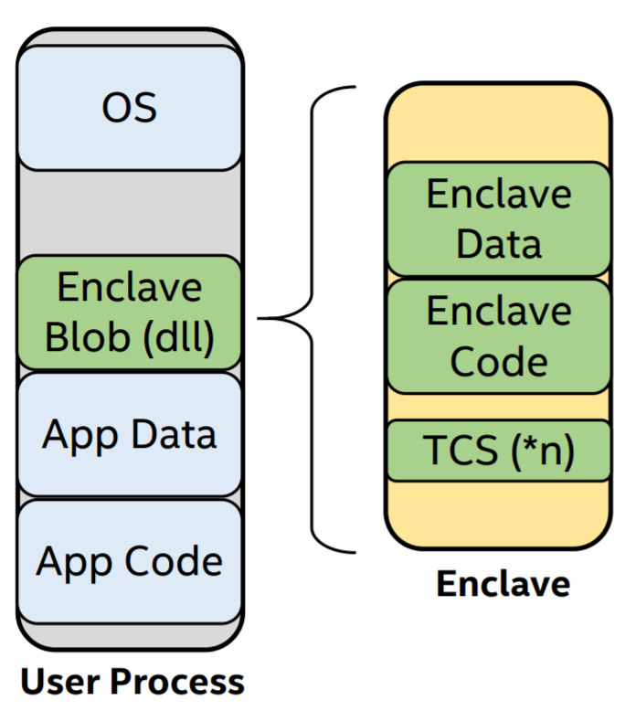
Process View of Intel SGX's Enclave
With its own code and data
Providing Confidentiality & Integrity
Controlled entry points
Multi-thread support
Full access to app memory and processor performance
Protected execution environment embedded in a process

Slide 65
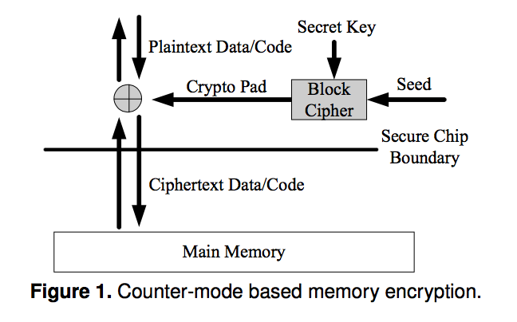
Memory Encryption: Defending Physical Attacks
Security: Pad is unique
Approaches:
global counter
block address

Slide 66
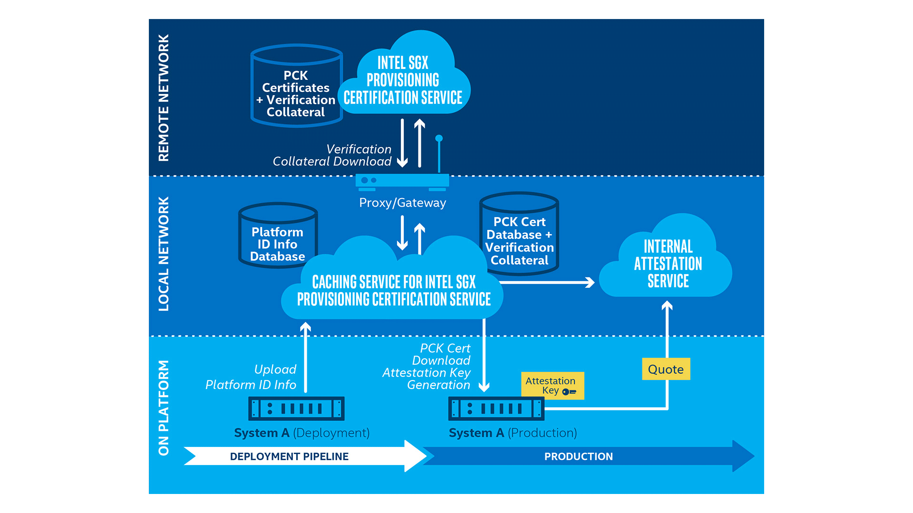
Remote Attestation (e.g., Intel SGX)

Slide 67


System: EnclaveDB
TEE: yet another virtual secure co-processor (SGX, TrustZone)
Commodity DB
(MS SQL Server)
Transaction
In-Mem DB (Hekaton) 🔑
In-Mem Tables/Indexes
Compiled Queries
eStored Procs
Logging
eResult
Recovery
Users
Query
Compilation
Commodity OS
(Windows)
Trusted Kernel
(threading, memory management, storage)
Commodity CPU
Commodity CPU (SGX)
Storage
Intel Skylake
e/ocall
(Currently) 128M EPC

Slide 68
EnclaveDB
Performance degradation due to EPC constraint:
40% overhead for TPC-C
Large TCB:
300K Hekaton + 25K trusted kernel
Require rich clients:
Client compiles SQL to StoreProcs
Reducing attacks on SQL parsing and compilation

Slide 69
Open Problem
Support complex SQL queries
Support efficient memory and branch-oblivious computations

Slide 70
Summary: Why Data Privacy is Hard?
The more data, the more valuable
Cause data aggregation
Data can be easily copied
It's really hard to prevent data copying
You can withdraw your money from bank, but how to revoke your data from the Internet?
More than tech
Law, like GDPR in Euro

